Slide 1
IRE of HCC with robotic assistance
Lukas P. Beyer, Benedikt Pregler, Christoph Nießen, Philipp Wiggermann

Slide 2
Patient history
62 years old, male
Liver cirrhosis Child B
Successfull microwave ablation of HCC in segment VII (03/2014)
HCC in segment IVa
3,4 x 3,0 cm
next to portal vein and recanalised V. umbilicalis

Slide 3
Preinterventional CT
V. umbilicalis
HCC
arterial phase

Slide 4
Procedure
IRE
Simultaneous placement of 5 needles
No heat sink effect
Robotic guidance (Perfint MAXIO)
Avoids use of CT fluoroscopy
Simultaneous placement of up to 6 probes
Exact positioning (+- 1mm)
Faster interventions

Slide 5
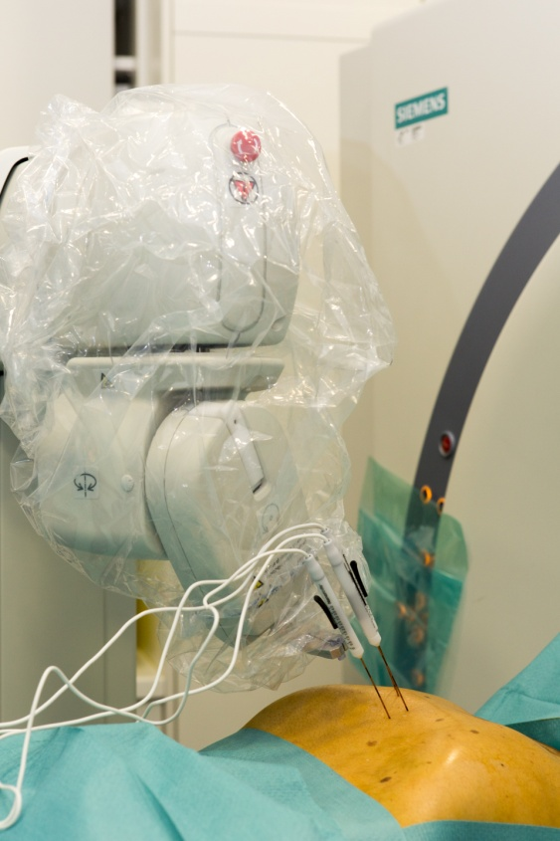
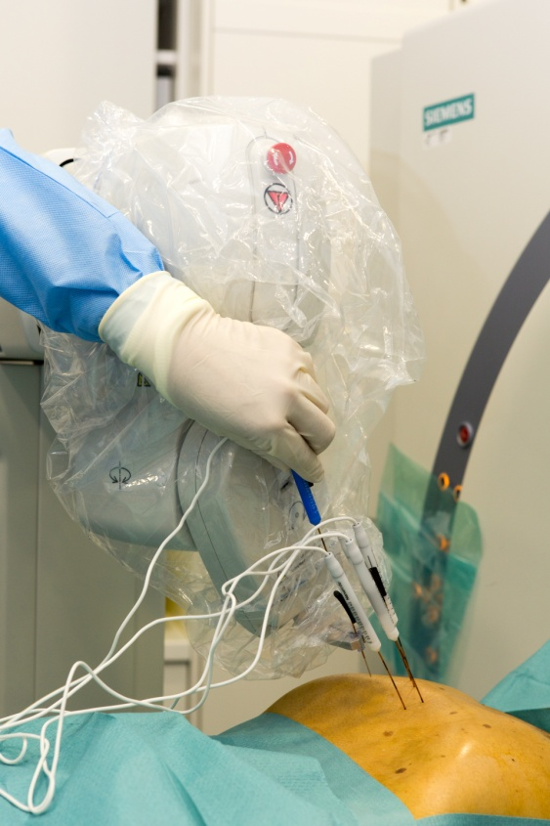
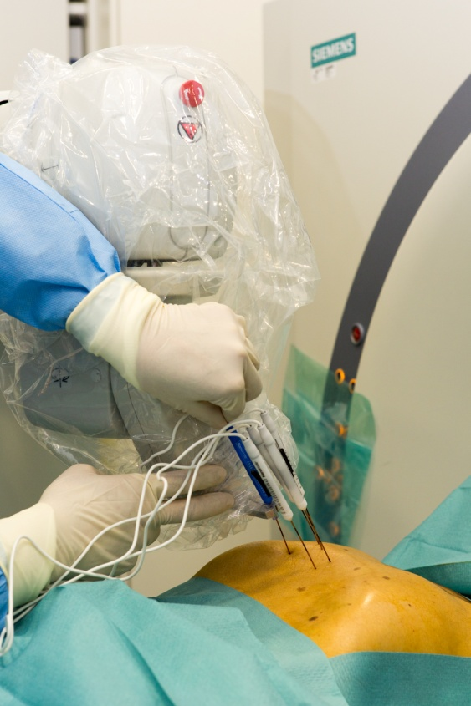
Assisted needle placement
Semi-automatic needle placement with Perfint MAXIO

Slide 6
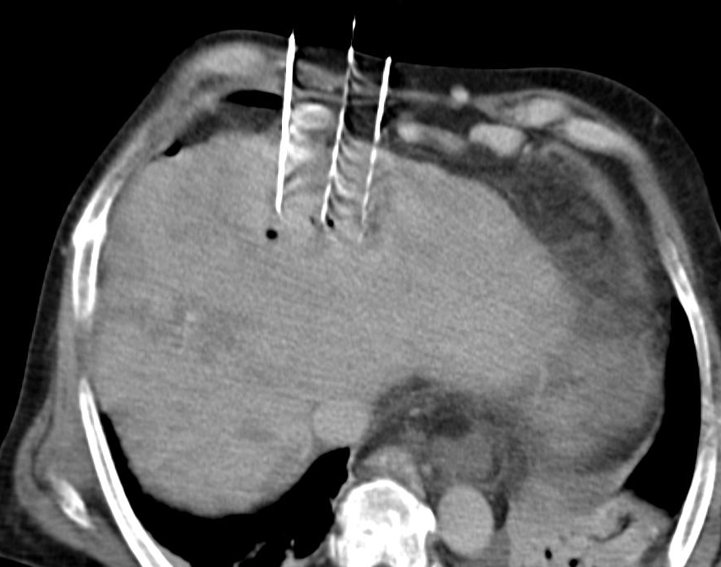
Periinterventional CT
IRE needle
V. umbilicalis
ablation area
native control scan

Slide 7
Follow-up (12 weeks)
complete ablation
no peri- or postinterventional complications
complete ablation in CEUS, MRI and CT

